Slide 1
Marathons Presentation

Slide 2
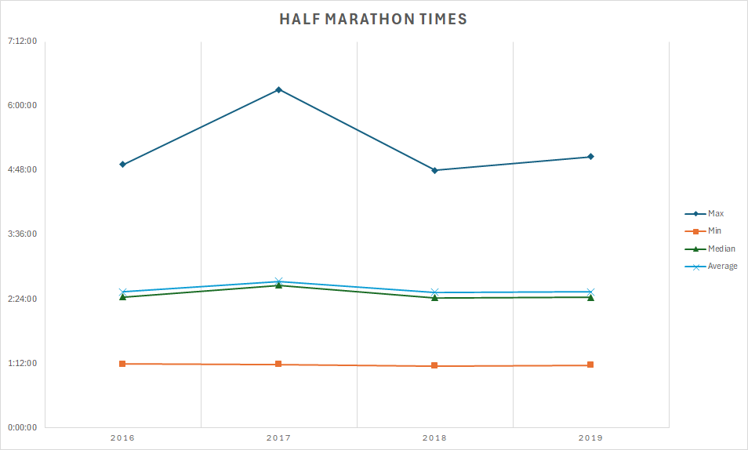
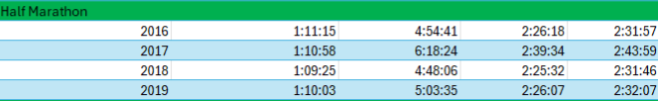
Talking Points
The slowest half marathon time was 6:18:24 in 2017
The fastest half marathon time was 1:09:25 in 2018
The greatest discrepancy in fastest and slowest times was in 2017 being 5:07:26
The smallest difference in fastest and slowest times was in 2016 03:43:26

Slide 3
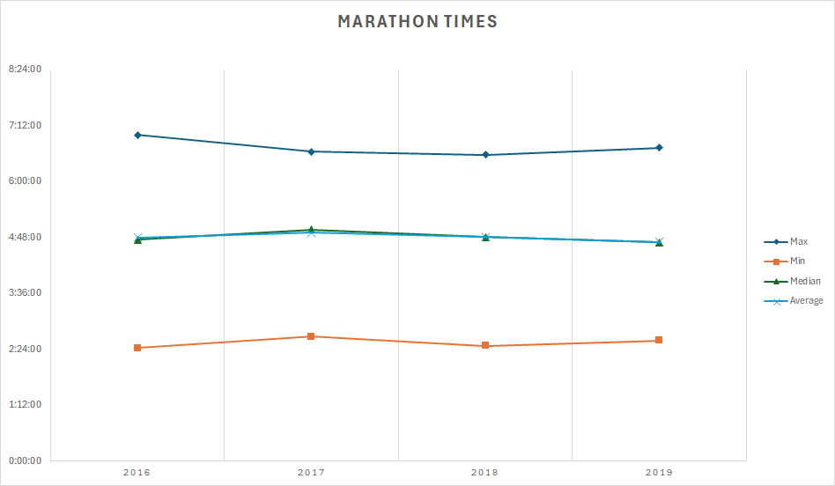

Talking points
-The slowest marathon time was 07:00:00 in 2016
The fastest marathon time was 02:25:42 in 2016
The greatest discrepancy in fastest and slowest times was in 2016 being 4:34:18
The smallest difference in fastest and slowest times was in 2017 being 03:57:54

Slide 4
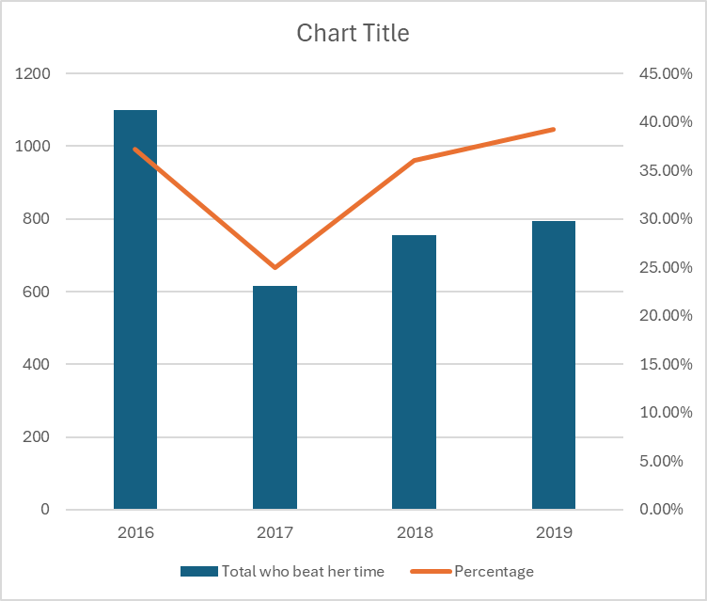


Oprah’s Time
Talking Points
-
2466 people ran in 2017 which was the second highest over the 4 years but was also the lowest percentage of runners that beat her time.
If you take out 2017, the average percentage of runners who beat her time were close in range. It begs the question to why this is the case.
Oprah Marathon 04:29:20
Total who Oprah Marathon 04:29:20
Total who beat her time
Column1
Column2
Percentage
2016
1099
Oprah Marathon 04:29:20
Total who beat her time
2016
1099
2017
615
2018
756
2019
793
37.23%
2017
615
615
615
24.94%
2018
756
756
756
36.00%
2019
793
793
793
39.20%
beat her time
Column1
Column2
Percentage
2016
1099
1099
1099
37.23%
2017
615
615
615
24.94%
2018
756
756
756
36.00%
2019
793
793
793
39.20%

Slide 5
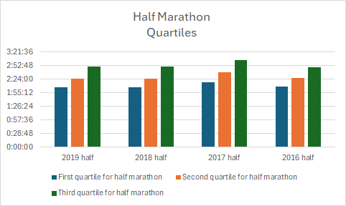
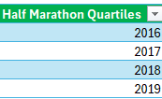

Half Marathon Quartiles
Based on the third quartile, every year there are more runners who are slower.
Each year the quartiles are consistent
In other words, the couch to half marathon training experience is easier than training for a marathon

Slide 6
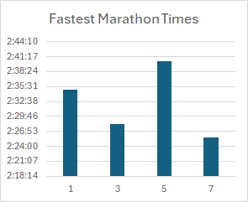
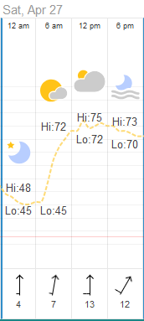
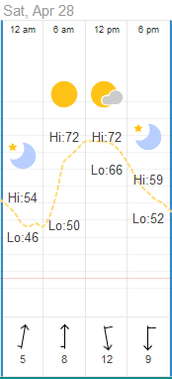
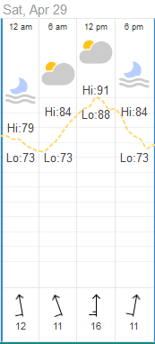
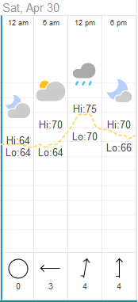
Hypotheses
2019 2018 2017 2016
Talking Points
We focused on the fastest times.
There are several points that can provide this answer.
Domain expertise really matters here, have the runners trained in bad weather? Are they prepared for the bad weather, e.g., a jacket, sunglasses, etc.
Q: Is there a year which runners seem slower or faster?
Race time was around 7 AM for each year.
There’s also humidity to consider.
Do runners generally slow when the sun comes out?
Route difficulty is also something to consider, i.e., 2016 may have had a flatter course than 2017.
Weather Data from https://www.timeanddate.com/weather/usa/nashville

Slide 7
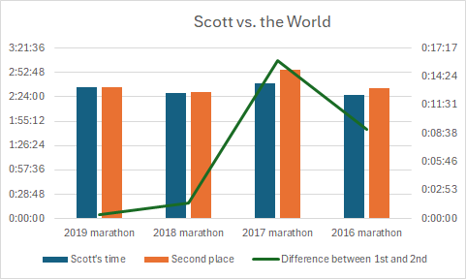

Scott Wietecha
Talking Points
-
Via Scott’s Strava page, we found out that Scott is the track and cross-country coach for Hendersonville High, which means he gets paid to train and run fast!
This is an unfair advantage to other runners, such as Dibran – who to my knowledge – does not get paid to train for marathons/half marathons!

